Slide 1



Free AI Tools for Academic Research
A Comprehensive Guide to Stage-Based AI Toolkits & Systematic Literature Search Strategies

Slide 2

Modern AI Research Ecosystem
Leveraging specialized open-access artificial intelligence tools to optimize literature discovery, synthesis, data analysis, and peer review compliance.

Slide 3






AI Tools by Research Stage
1. Literature Search
2. Literature Mapping
3. Note-Taking
4. Data Analysis
5. Visuals & Editing
Semantic & AI Search
Citation Graphs
RAG & Synthesis
Open Statistics
Proofing & Diagrams
•
Semantic Scholar
•
ResearchRabbit
•
Google NotebookLM
•
JASP
•
diagrams.net / Inkscape
•
Search Smart
•
Inciteful
•
Notion AI
•
Simple ML for Sheets
•
Meta AI / Bing Creator
•
Consensus
•
Open Knowledge Maps
•
Glasp
•
R Project
•
ChatGPT / Hemingway
•
Scinapse
•
VOSviewer
•
Zotero / Mendeley
•
R Discovery
•
Connected Papers

Slide 4



The 3-Tier Literature System
Tier 1: Foundational (5 Papers)
Tier 2: Directly Related (15 Papers)
Tier 3: Emerging Trends (10 Papers)
Established theoretical frameworks and seminal papers defining the field.
Studies directly examining your target variables and methodologies.
Recent publications highlighting novel directions and state-of-the-art developments.
•
Answers: What is the field built upon?
•
Identifies patterns & contradictions
•
Uncovers current technological pushes
•
Extract core definitions & paradigms
•
Maps methodological variances
•
Explores interdisciplinary applications
•
High citation impact & canonical status
•
Pinpoints explicit research gaps
•
Informs future recommendation models

Slide 5
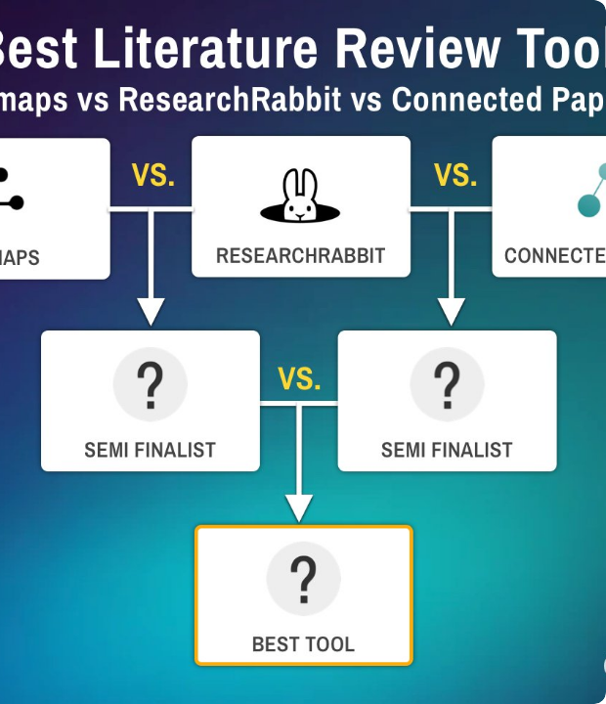
Literature Mapping & Network Tools
Citation Graph Visualization
Visual mapping transforms linear literature searching into an intuitive, network-based exploration process.
Co-Citation & Bibliometric Clustering Connected Papers & Inciteful generate interactive graphs connecting derivative works and predecessor studies.
Dynamic Bibliography Tracking ResearchRabbit monitors your collections to automatically suggest newly published relevant papers.

Slide 6
8-Stage AI Research Workflow
2. Map
4. Synthesize
6. Illustrate
8. Cite
Graph networks
NotebookLM notes
Diagrams & vector
Zotero manager
1. Find
3. Filter
5. Analyze
7. Refine
Semantic search
3-Tier triage
JASP statistics
Editing & clarity

Slide 7

Search & Discovery Tools Matrix
Tool Name | Primary Classification | Core Value Proposition | Best Use Case
Semantic Scholar | Literature Search | AI-driven paper impact graphs & TLDR summaries | Rapid initial keyword & topic discovery
Consensus | Literature Search | Extracts direct claims from peer-reviewed literature | Evaluating consensus on specific claims
Search Smart | Database Selection | Recommends optimal academic search engines | Matching niche topics with databases
Scinapse | Discovery Engine | Big-data paper analysis and author impact profiling | Comprehensive literature indexing
R Discovery | Personalized Feed | Mobile & web customized research feeds | Staying updated on topic notifications

Slide 8


Note-Taking & Data Analysis AI
Grounding & Note Synthesis
Open Data Analysis Engines
Modern AI note-taking platforms eliminate hallucination risks by anchoring LLMs strictly to uploaded PDFs.
Free, reproducible statistical suites tailored for academic research without expensive licenses.
•
Google NotebookLM: Uses Retrieval-Augmented Generation (RAG) strictly grounded in source documents.
•
JASP: Open-source Bayesian and frequentist statistical analysis software.
•
Simple ML for Sheets: Machine learning models integrated directly into Google Sheets.
•
Notion AI: Centralized database organization for literature logs and tagging.
•
R Project: Comprehensive programming environment for reproducible data science.
•
Glasp: Social web highlighter for capturing direct quotes and marginalia.

Slide 9

Visuals, Editing & Proofreading
Category | Selected AI / Open Tools | Primary Research Function
Flowcharts & Vectors | diagrams.net, Inkscape | Creating high-resolution, vector-graphics methodology figures and process flow diagrams.
Scientific Visuals | Meta AI, Bing Image Creator | Generating conceptual visual metaphors and graphical abstract background assets.
Text Style & Flow | Hemingway Editor, Paraphraser | Auditing readability index, eliminating passive voice clutter, and enhancing sentence structure.
Grammar & Tone | ChatGPT (Prompt-guided) | Polishing tone to adhere to strict academic style guides (e.g., APA, IEEE, Nature).

Slide 10
Preventing AI Hallucinations
Use Document-Grounded RAG Tools: Prefer systems like Google NotebookLM or local vector databases that answer questions strictly using your uploaded PDF repository.
Verify DOI & Direct Citations: Never accept citations produced by general LLMs (e.g., standard ChatGPT) without verifying the DOI on PubMed or CrossRef.
Triangulate Claims with Consensus: Cross-check claims using Consensus or Elicit to ensure statements reflect empirical peer-reviewed findings rather than generated text.
Human-in-the-Loop Oversight: Treat AI outputs exclusively as preliminary drafts or analytical summaries requiring expert academic verification.

Slide 11


Reference Management Tools
Automated Metadata & PDF Sync
Workflow Integration
Seamlessly capturing bibliographies, metadata, and full-text PDFs across desktop and web workflows.
Linking reference managers with writing suites for friction-free in-text citation.
•
Word & Google Docs Plugins: Real-time automated bibliography formatting.
•
Zotero: Fully open-source manager with powerful browser connectors and plugin ecosystem (e.g., ZotFile).
•
LaTeX & Overleaf: Direct `.bib` file integration for automated formatting.
•
Mendeley: Cloud-connected reference library with built-in PDF annotation tools.
•
AI Tagging Sync: Exporting libraries into ResearchRabbit or Inciteful for network mapping.
•
JabRef: Native BibTeX manager tailored for LaTeX manuscript preparation.

Slide 12
Build Your AI Research Stack
Combine literature discovery, mapping networks, grounded note synthesis, and open reference managers into a systematic, reproducible workflow.

Slide 13

Image Sources
https://effortlessacademic.com/wp-content/uploads/2025/12/2025-Best-Lit-Review-Tool-Competition.jpg
Source: effortlessacademic.com

